Slide 1
Start to Finish Twitter Marketing For Startups
Exactly How to use Twitter as a Serious Traction Channel
By Derric Haynie
Derric.link/twitter
/facebook
/linkedin
/snapchat
/growthhackers
/inbound
/quora
/rebrandly-blog

Slide 2
Slides:
Derric.link/slides

Slide 3
All Things You Need
Don’t Bother if You Don’t Have:
Blog Content
Tracking Setup On Your Website
4 Hours per Week
$0 - $100 / month
A Well Designed Inbound Marketing Funnel
Derric.link/twitter
Derric.link/slides

Slide 4
All Things Not Covered
Figure this shit out on your own:
Content Marketing Strategy
Deep Understanding of Your Target Audience
Deep Twitter Insights
The Exact Offers and Messages To Send Your Audience
Your Overall Social Media Marketing Strategy
How to Manage 100k+ Social Media Accounts
Derric.link/twitter
Derric.link/slides

Slide 5
Pop Quiz:
How Often Should You Sell on Social Media?
Derric.link/twitter
Derric.link/slides

Slide 6
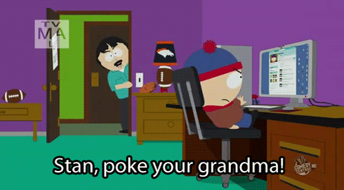
3 Laws of Twitter Marketing
Give Value At All Times
Mange Your Shit
Absolutely No Selling
Derric.link/twitter
Derric.link/slides

Slide 7
Tweet This Shit: derric.link/tweet
Social Media Marketing is Simply Word of Mouth Marketing, Online.
Derric.link/twitter
Derric.link/slides

Slide 8
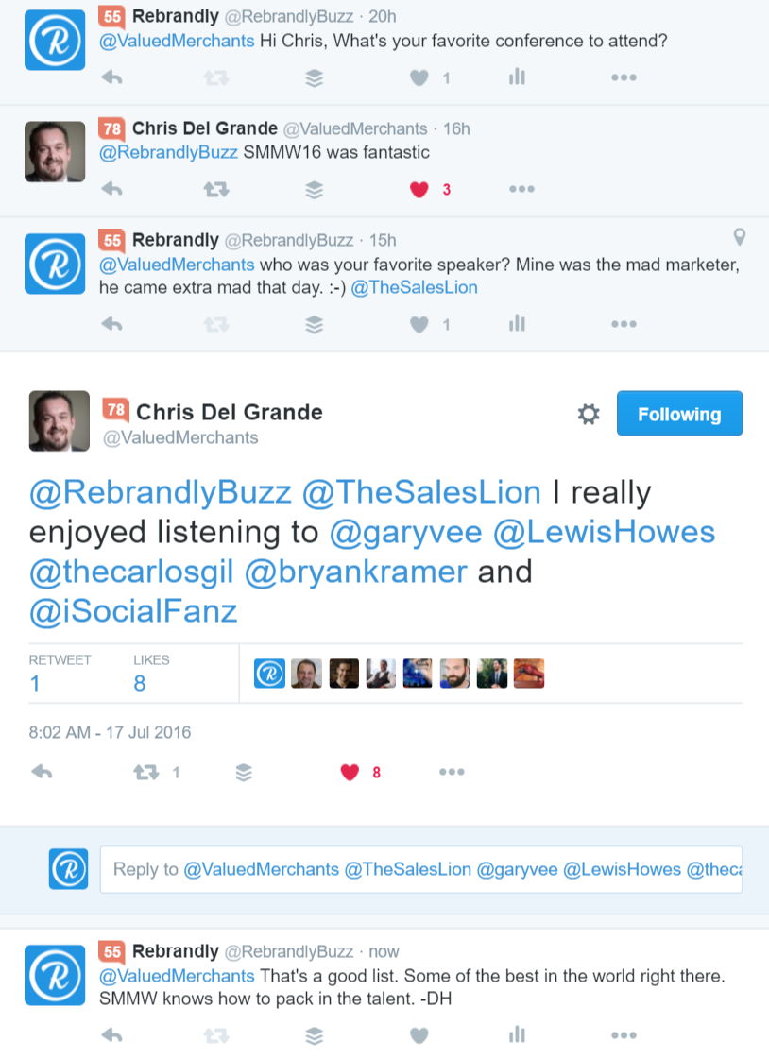
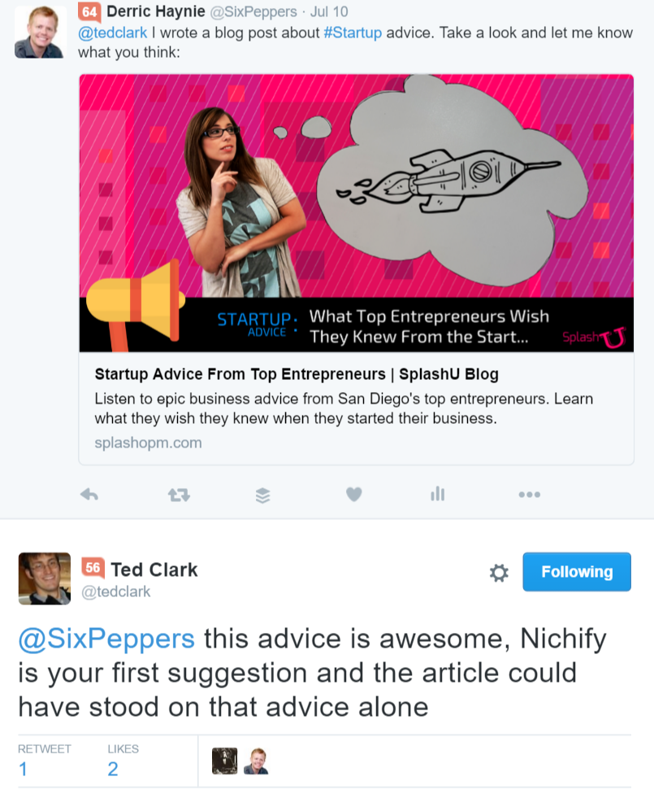
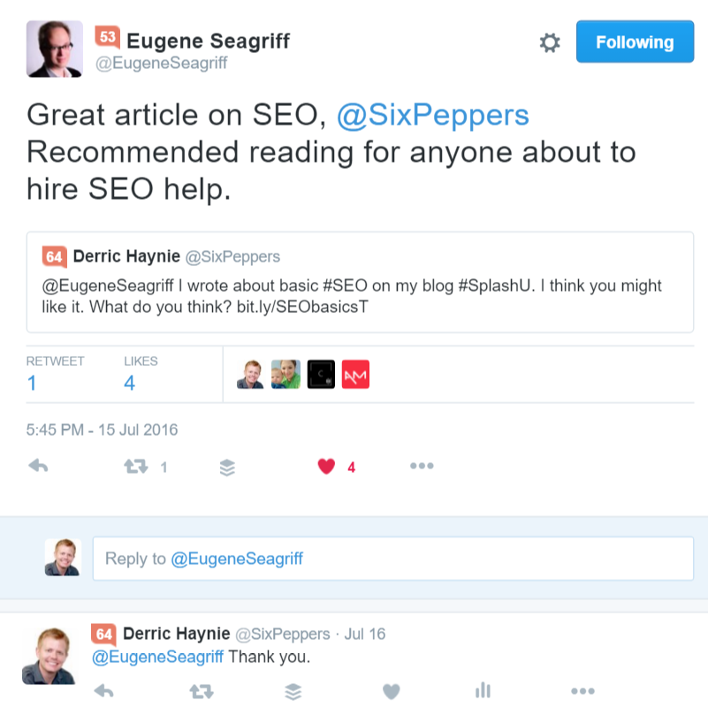
Step 1: Auto-Mentions
Derric.link/twitter
Derric.link/slides

Slide 9
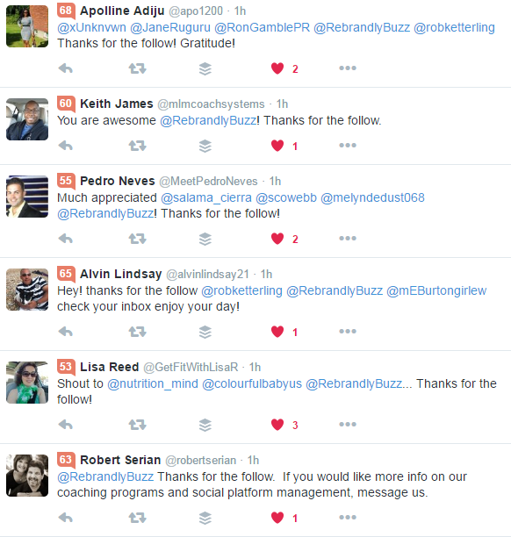
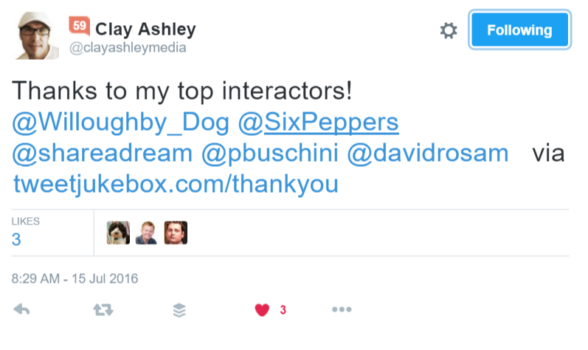
Auto-Mentions Done Wrong
Derric.link/twitter
Derric.link/slides

Slide 10
Done Right
Auto-Mentions
Are:
Are Not:
Conversation Starters
Opportunities to Provide Value
Engagement Increasers
Open For Anyone to Chime in
Intrusive
Private
Meant to Capture Leads
Meant to Drive Traffic
Derric.link/twitter
Derric.link/slides

Slide 11
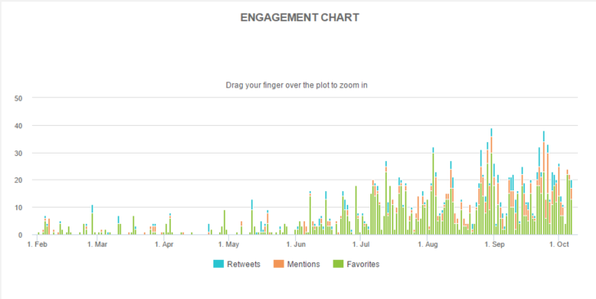
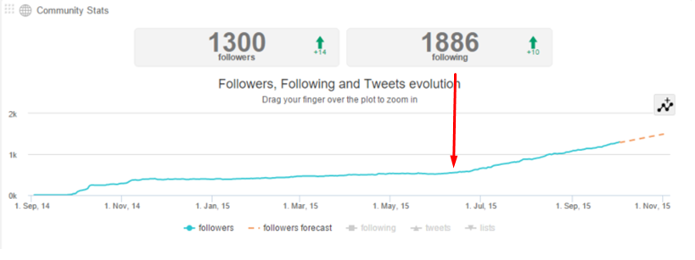
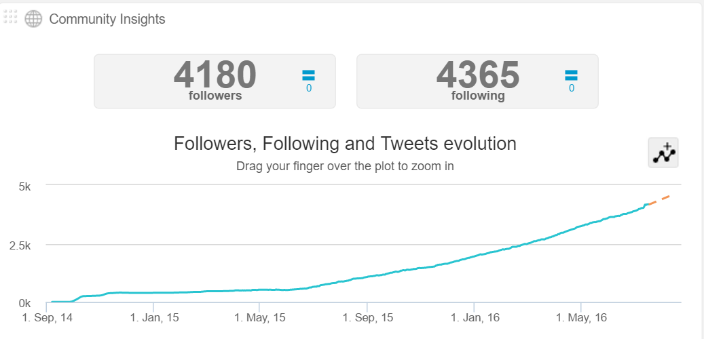
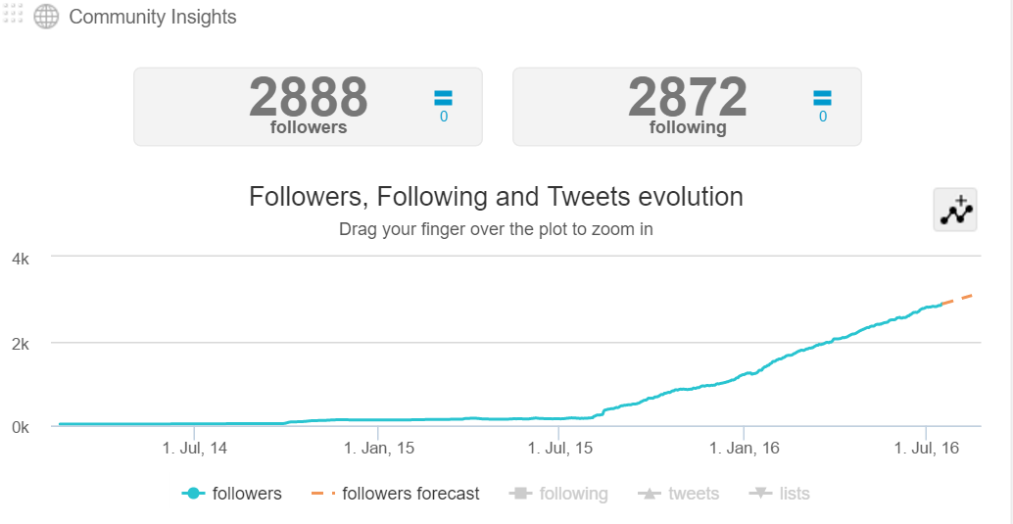
Step 1: Auto-Mentions Work
Derric.link/twitter
Derric.link/slides

Slide 12
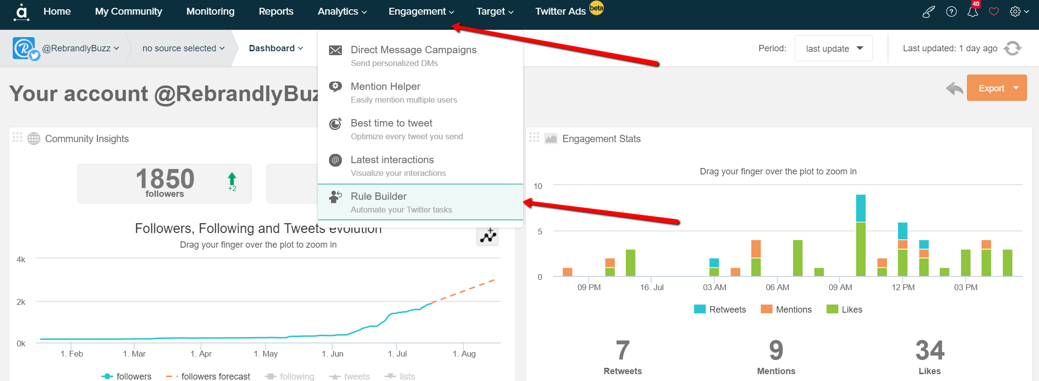
Audiense: How to Use Rule Builder
Derric.link/Audiense
Derric.link/twitter
Derric.link/slides

Slide 13
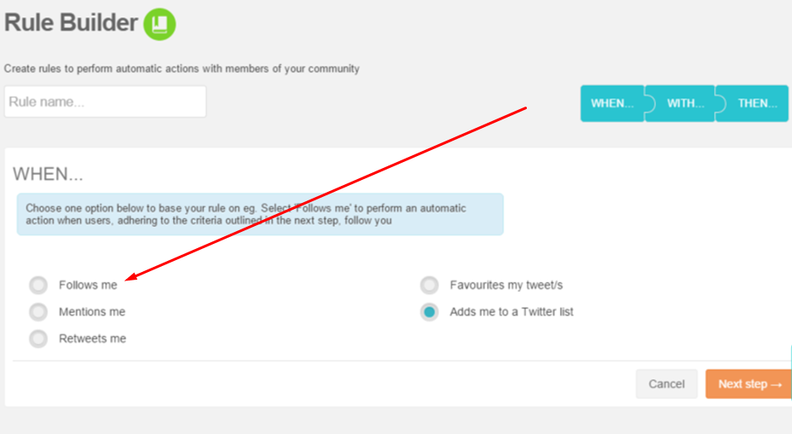
1. Choose Follow Me
Derric.link/Audiense
Derric.link/twitter
Derric.link/slides

Slide 14
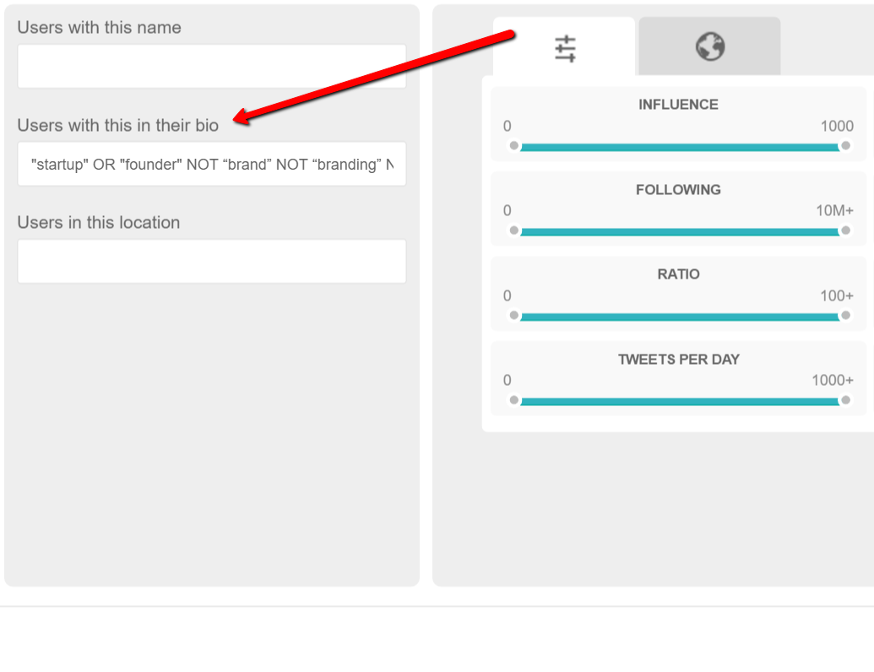
2. Choose Your Target Audience
Syntax:
"startup" OR "founder" NOT “brand” NOT “branding” NOT “#SMM” NOT “SMM” NOT “Social Media” NOT “Social Media Manager”
Derric.link/Audiense
Derric.link/twitter
Derric.link/slides

Slide 15
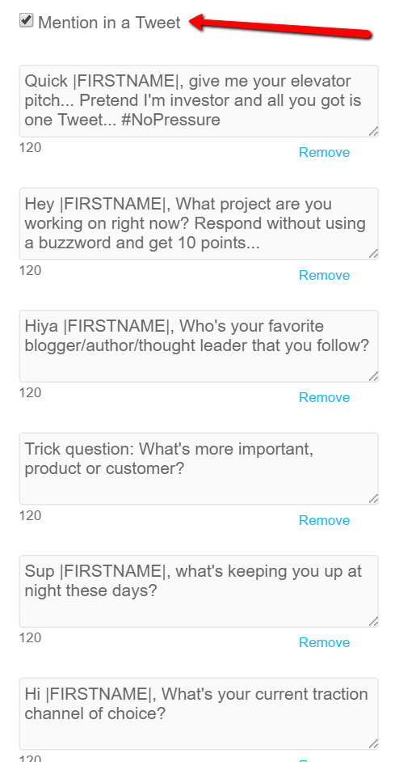
3. Create Your Content
Derric.link/Audiense
Derric.link/twitter
Derric.link/slides

Slide 16
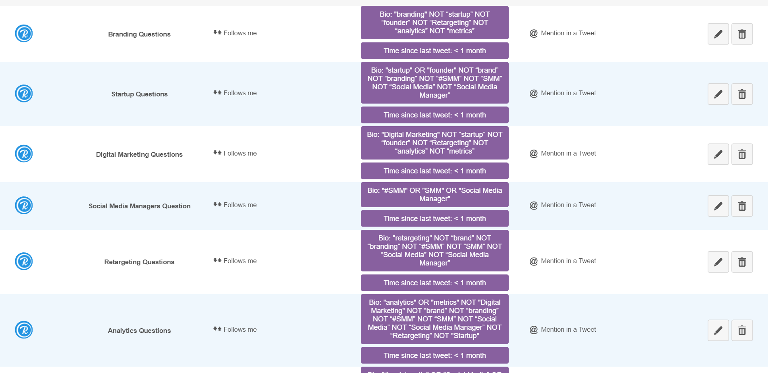
Create For Each Niche
Derric.link/Audiense
Derric.link/twitter
Derric.link/slides

Slide 17
3 Rules of Auto-Mentions
Only point people to things that are completely free
Respond to every response
Only use this strategy when people follow you
Derric.link/twitter
Derric.link/slides

Slide 18
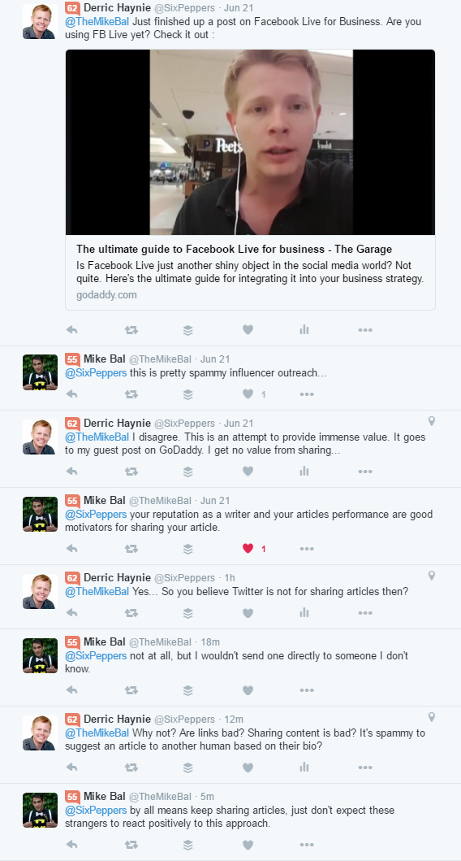
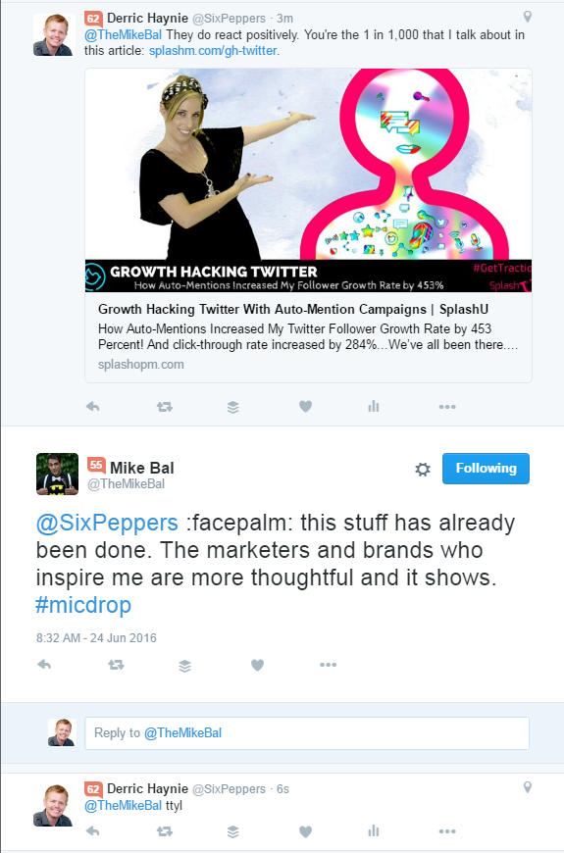
Does this backfire?
Aim to piss off 1/1000 people.
Hug Your Haters…
Troll The Trolls
Derric.link/twitter
Derric.link/slides

Slide 19
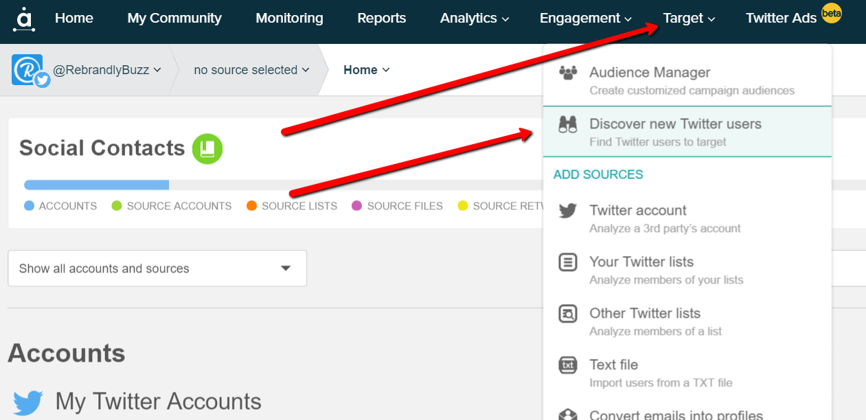
Step 2: Follow / Unfollow
Derric.link/twitter
Derric.link/slides

Slide 20
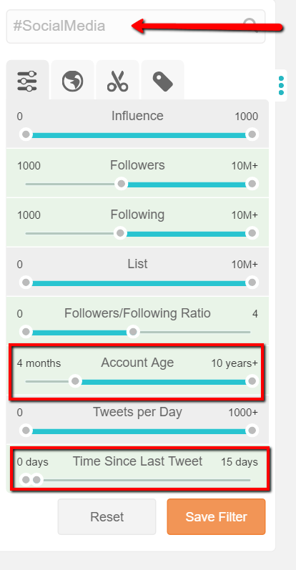
Filter For Your Most Ideal Audience
Keyword(s) that your audience uses to describe themselves.
Start with the influencers, not the scrubs
Helps ensure they will follow back
4 months+ to prevent fake accounts
Recent activity ensures active user
Derric.link/twitter
Derric.link/slides

Slide 21
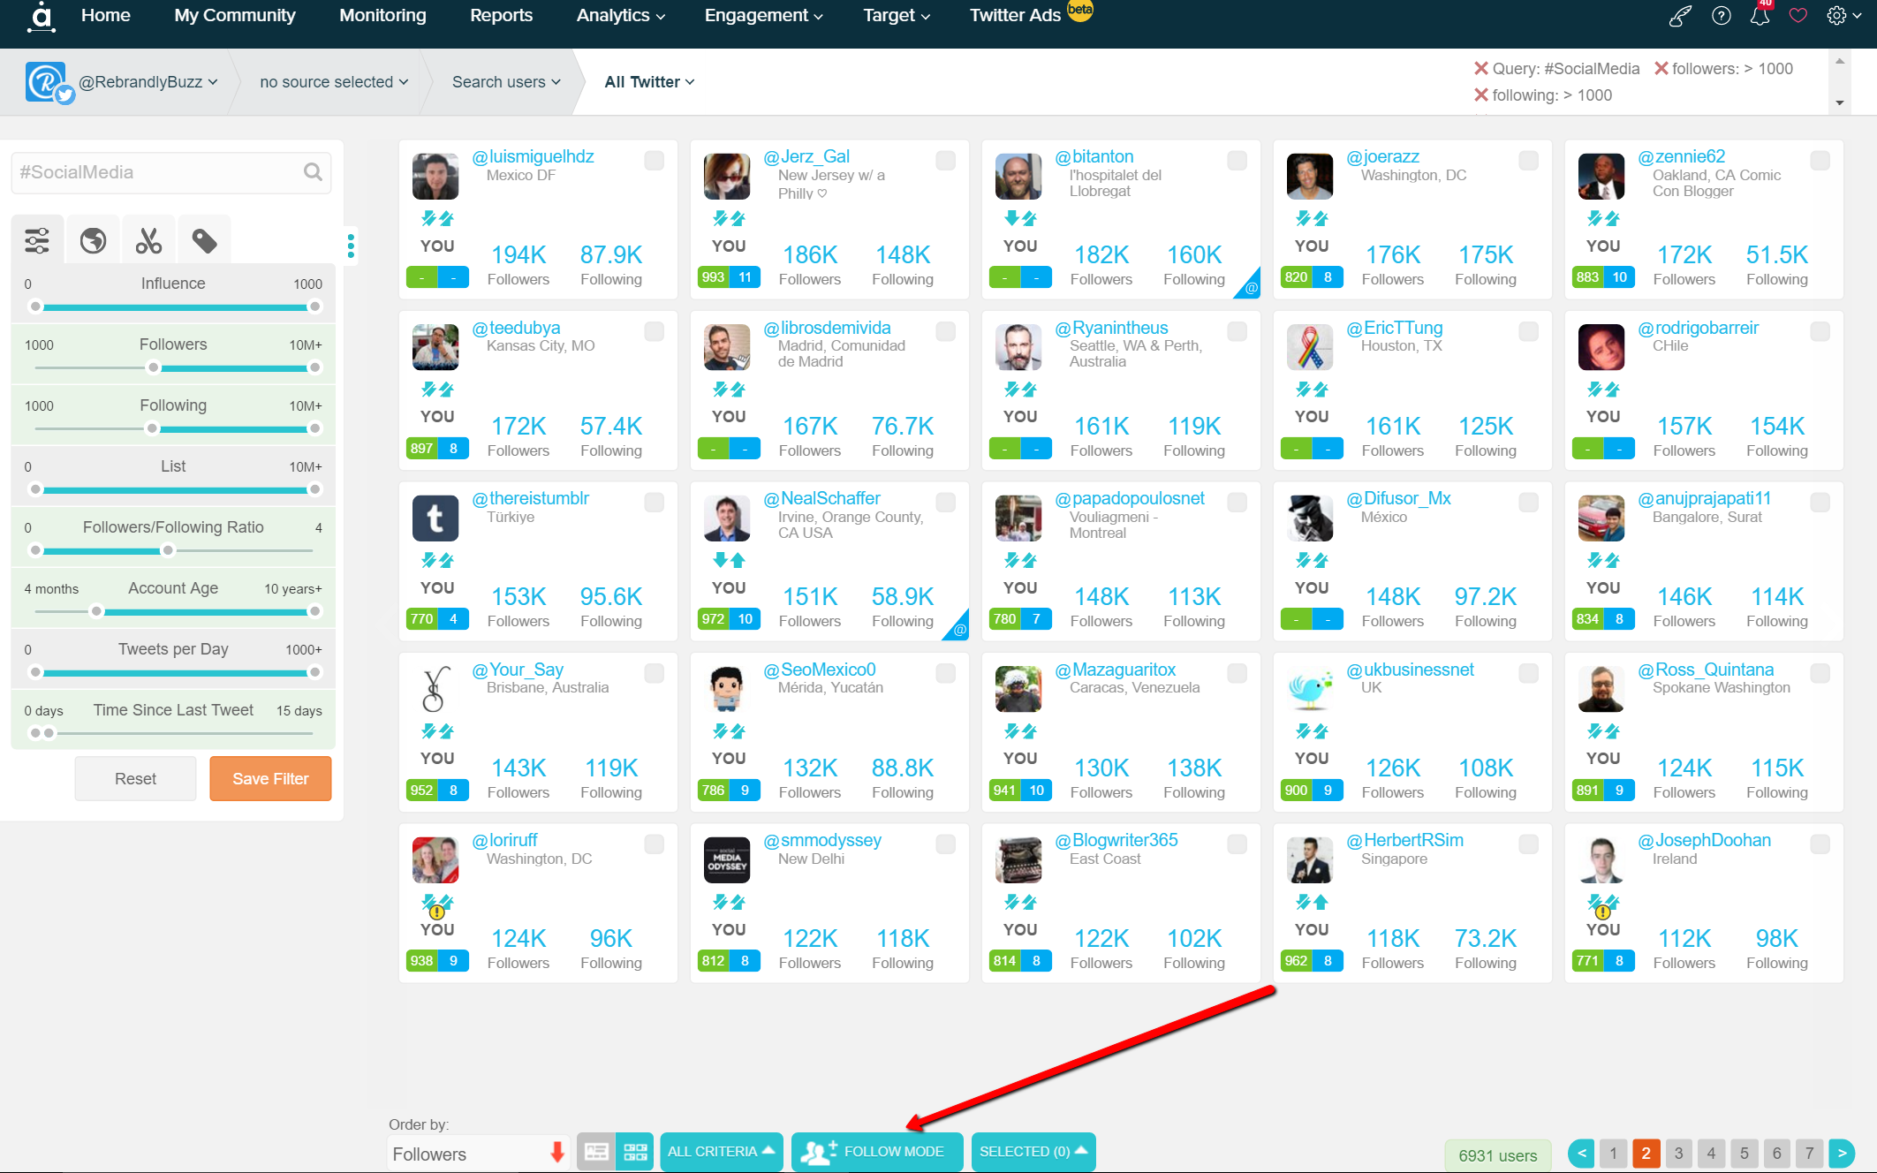
Enable Superpowers
Derric.link/twitter
Derric.link/slides

Slide 22
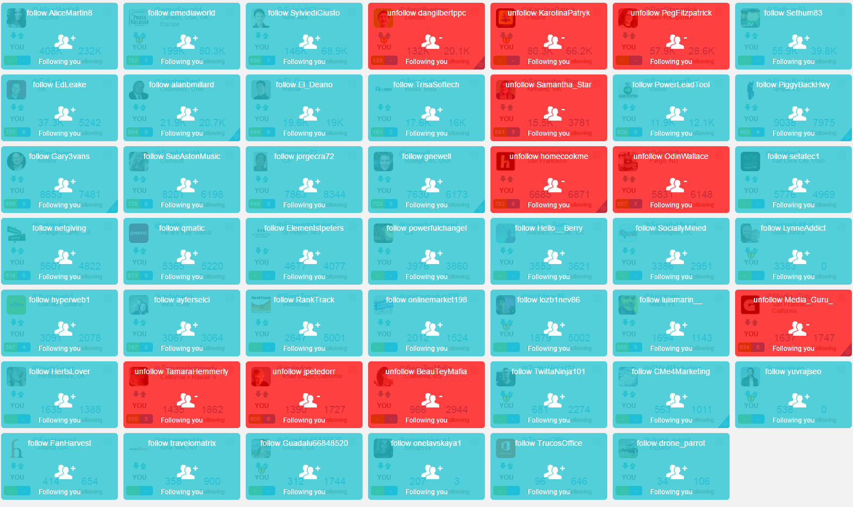
Follow Everyone
Derric.link/twitter
Derric.link/slides

Slide 23
Option 1: Unfollow Back
Derric.link/twitter
Derric.link/slides

Slide 24
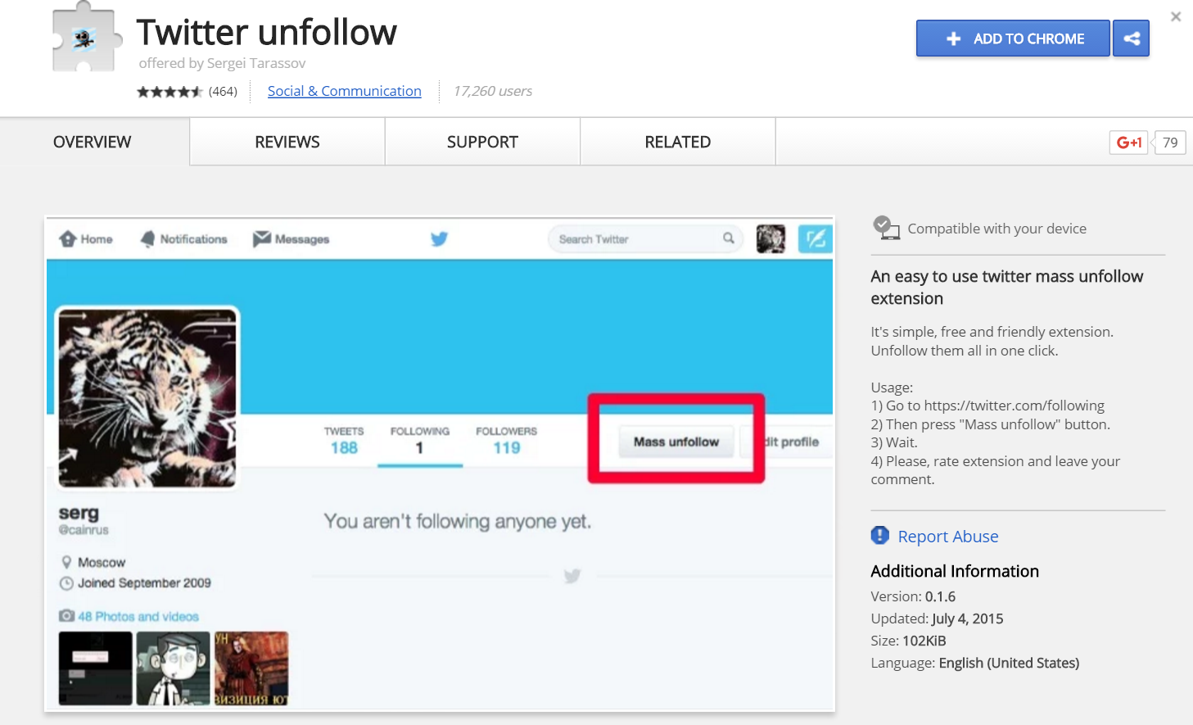
Mass Unfollow
derric.link/mass-unfollow
Derric.link/twitter
Derric.link/slides

Slide 25
Step 3: Content Curation
Flipboard - rebrand.ly/flipboard
Meet Edgar - rebrand.ly/meetedgar
Rebrandly - rebrand.ly/extension
Derric.link/twitter
Derric.link/slides

Slide 26
Why Content Curation?
Increase Tweet Frequency
Direct Our Audience to Relevant Content
Pull from Existing User Bases and Hashtags
Derric.link/twitter
Derric.link/slides

Slide 27
What to Curate?
Evergreen Only (No Breaking News)
Choose Specific Categories
Find Your Top 10-25 Industry Blogs
Derric.link/twitter
Derric.link/slides

Slide 28
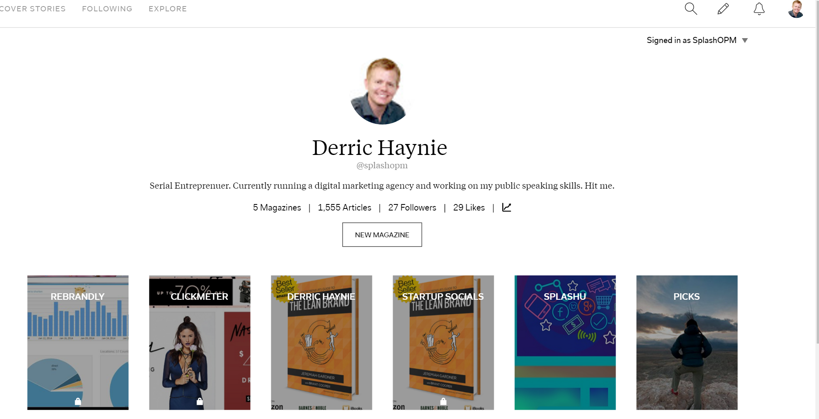
Create Magazine in Flipboard
Rebrand.ly/flipboard-login
Derric.link/twitter
Derric.link/slides

Slide 29
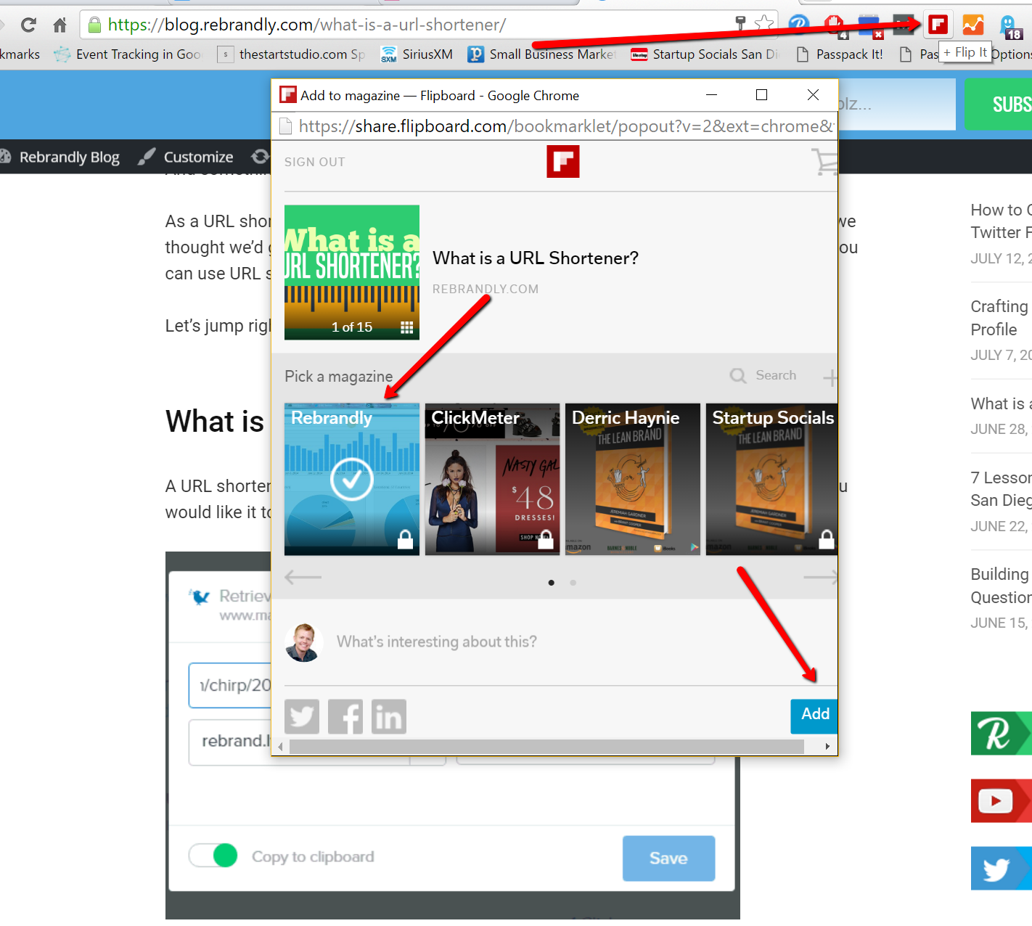
Flip Your Favorite Blog Posts
Derric.link/twitter
Derric.link/slides

Slide 30
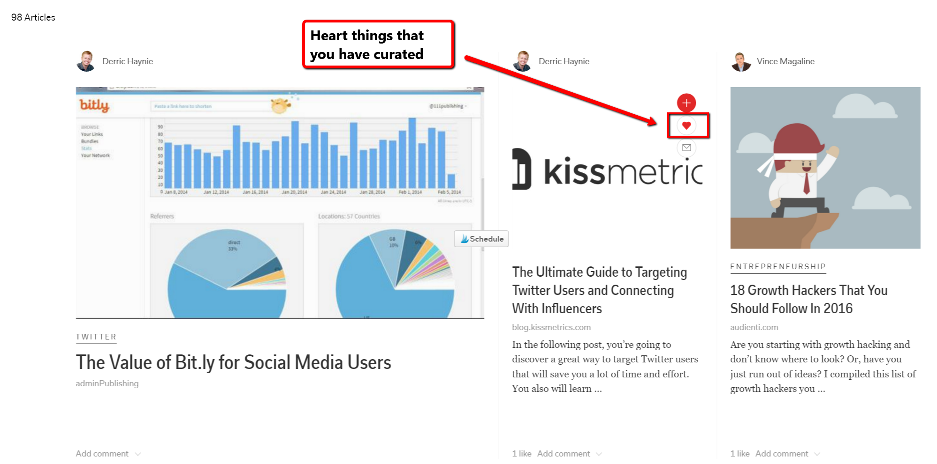
Dive Into Your Content Library
Derric.link/twitter
Derric.link/slides

Slide 31
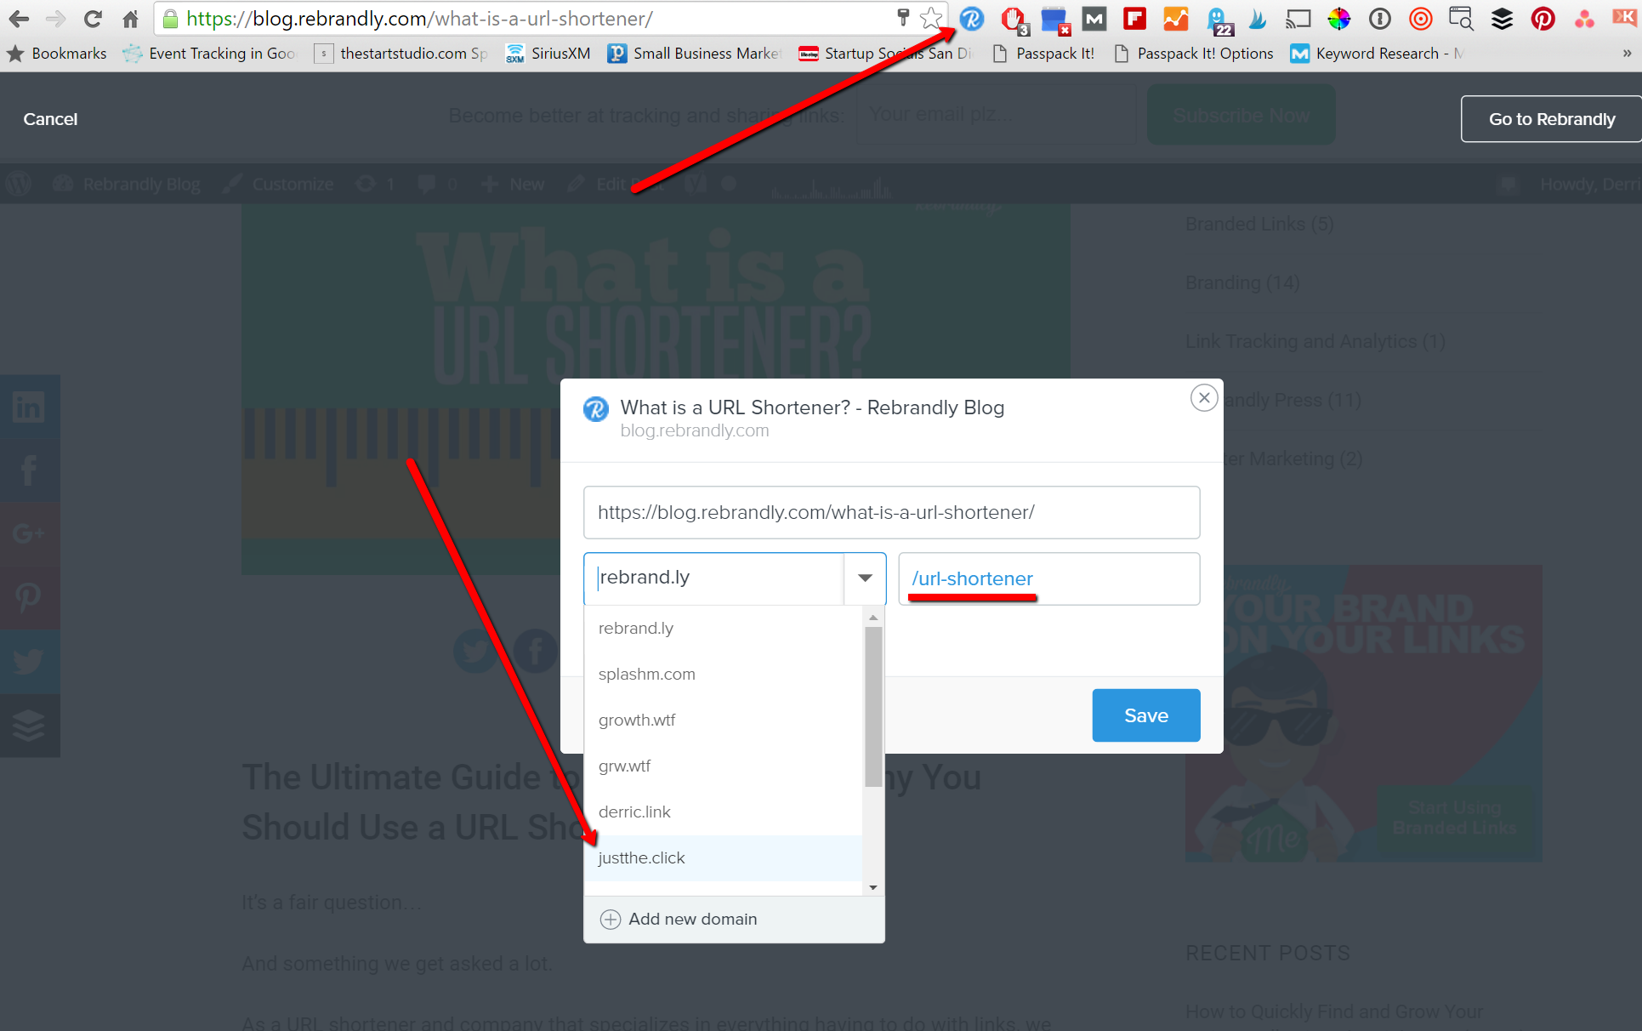
Create Branded Tracking Link
Derric.link/twitter
Derric.link/slides

Slide 32
Tweet This Shit: derric.link/rule
The Number One Rule for Link Sharing on Twitter: Make the Link Look Trustworthy! #Duh #BetterMarketing
Derric.link/twitter
Derric.link/slides

Slide 33
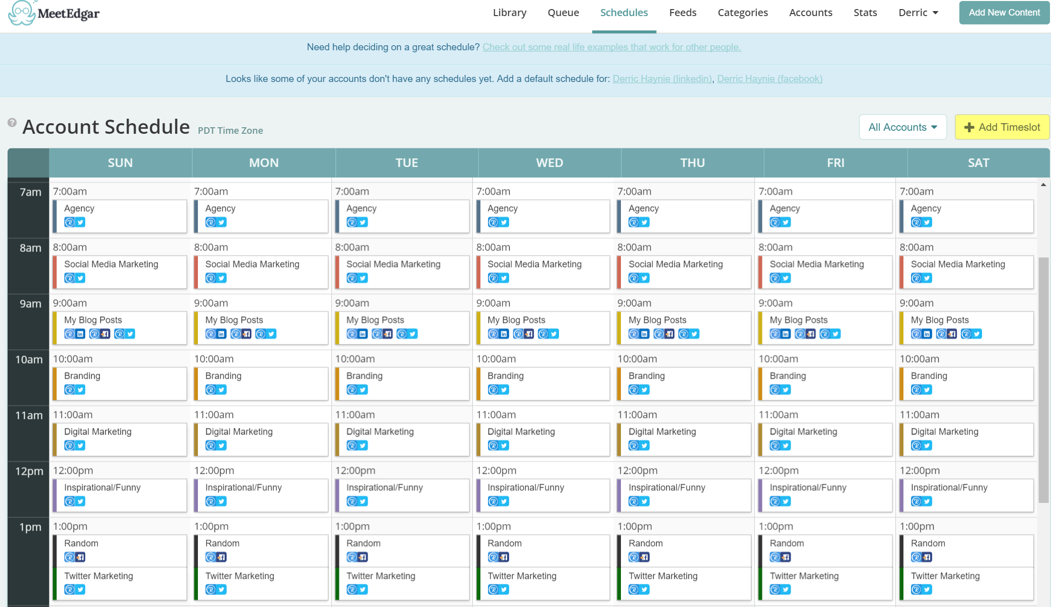
Why Meet Edgar?
Derric.link/twitter
Derric.link/slides

Slide 34
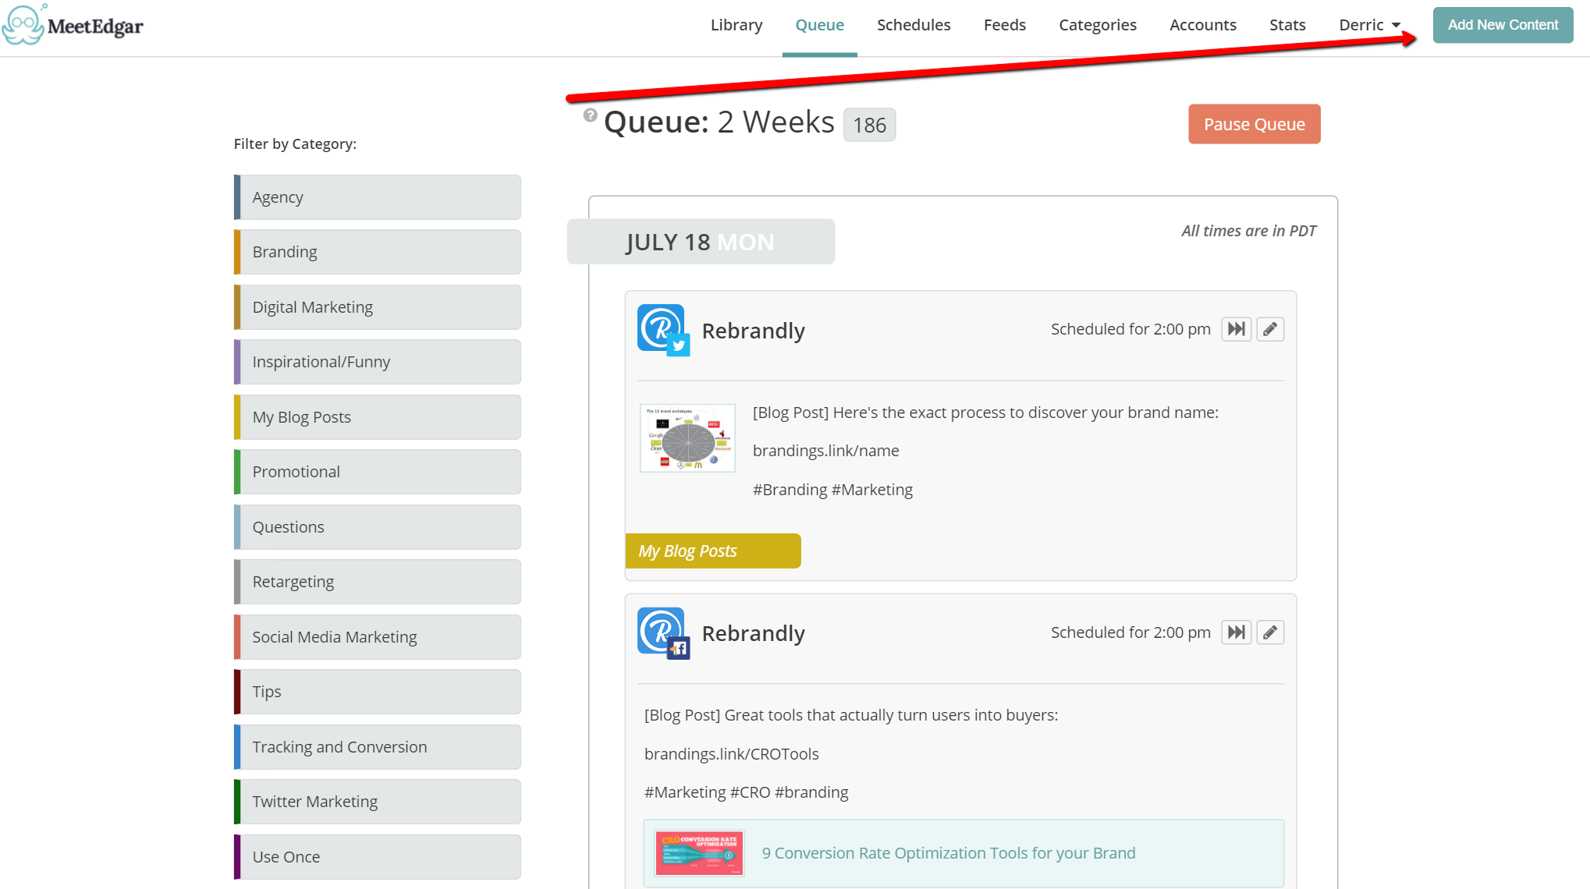
Create Social Post in Meet Edgar
Derric.link/twitter
Derric.link/slides

Slide 35
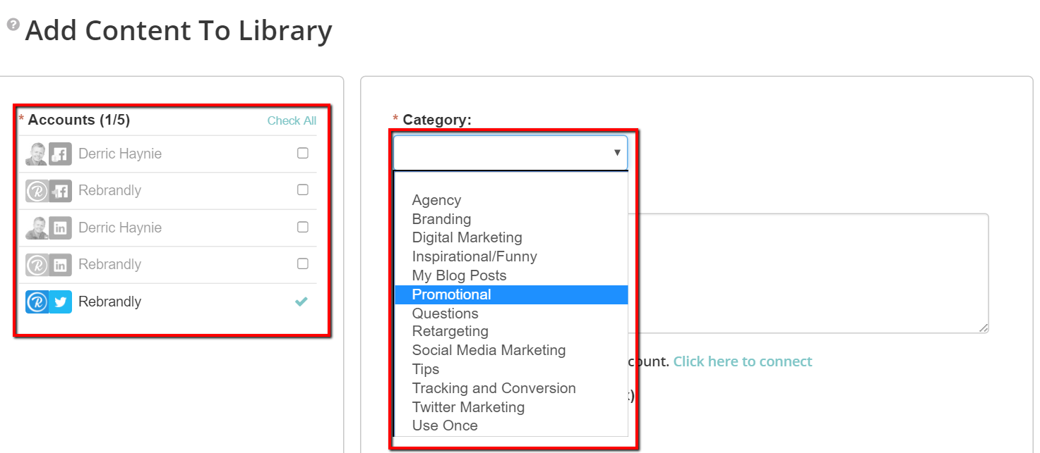
Select Account and Category
Derric.link/twitter
Derric.link/slides

Slide 36
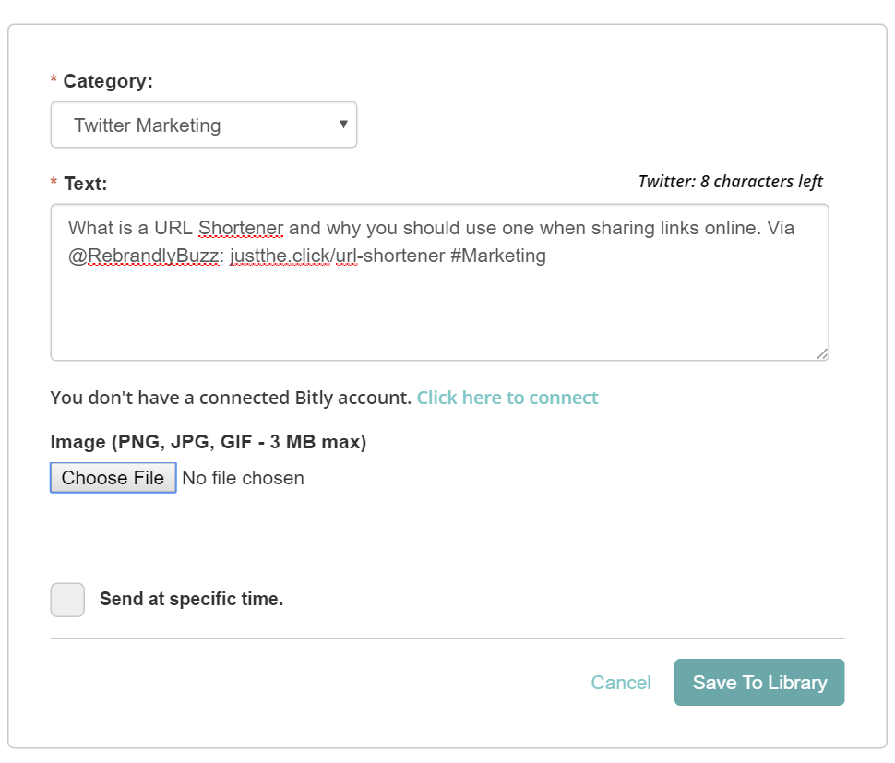
Write Your Post
Derric.link/twitter
Derric.link/slides

Slide 37
Steal Main Image
Derric.link/twitter
Derric.link/slides

Slide 38
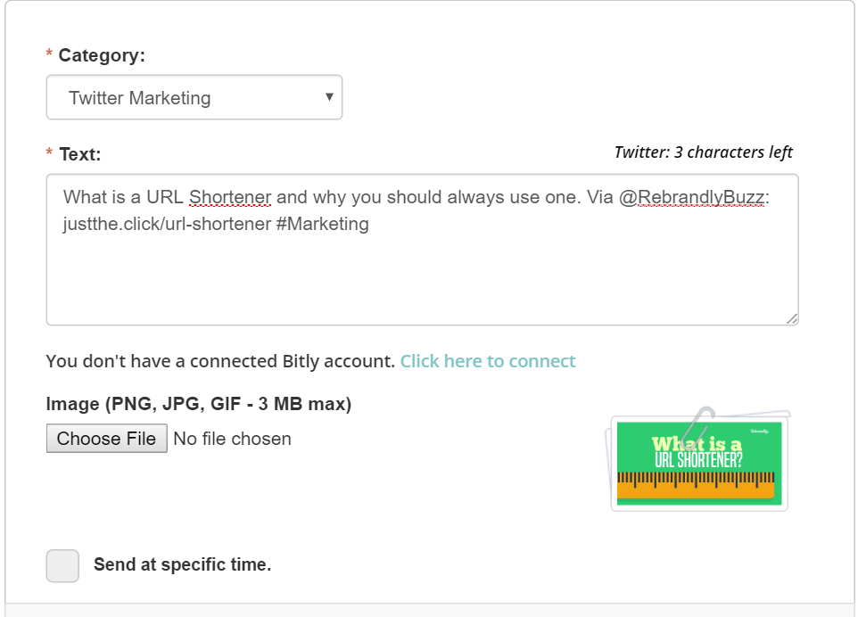
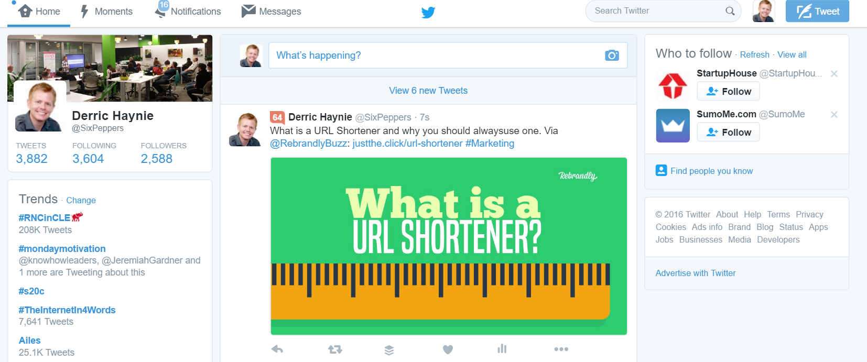
Save and Move to the Next
Derric.link/twitter
Derric.link/slides

Slide 39
Monthly Cleanup
Study Top 25% Performing Clicks in Rebrandly and Double Down
Find More Of That Content Type
Write Content On Those Topics
Duplicate Content With Other Headlines and Images
Remove Bottom 25% Performing
Check for Expired Content
Derric.link/twitter
Derric.link/slides

Slide 40
Next Steps
Put Your Own Blog Content in Meet Edgar
Gifs, Fun Tweets, Quotes
Retweet and Favorite Strategy
Twitter Chats
Derric.link/twitter
Derric.link/slides

Slide 41
Tweet This Shit: derric.link/expert
I Just Became a Twitter Marketing Expert in 30 Minutes or Less. Thanks @SixPeppers.
Derric.link/twitter
Derric.link/slides

Slide 42
Questions
Me:
@SixPeppers
Slide Deck:
Derric.link/slides
Plz Follow:
@RebrandlyBuzz

